Slide 1


DATA MODELING
Architecting Relationships
NEWCC – NORTHEAST WISCONSIN CODE CAMP

Slide 2

ABOUT ME
Trevor Fayas
Kentico MVP
Senior Software Engineer – Heartland Business Systems
Gamer
Philosopher
Homesteader

Slide 3

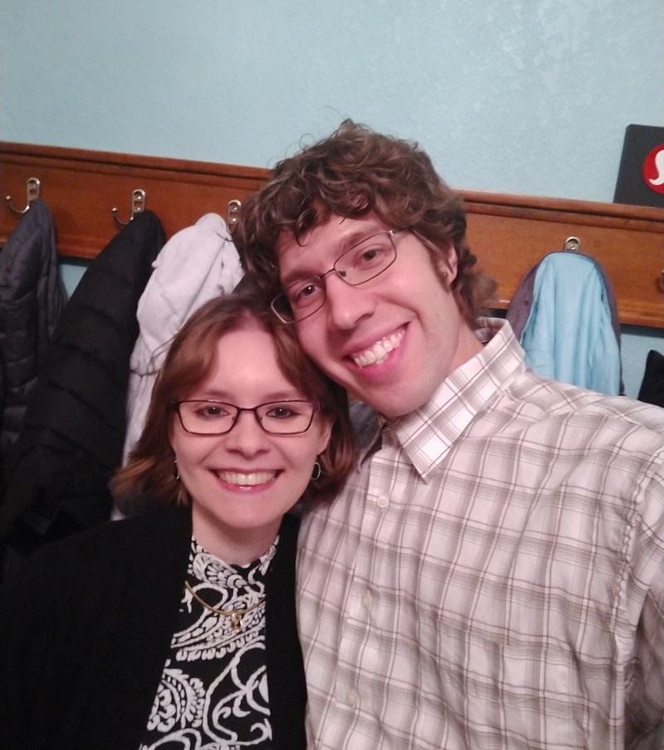
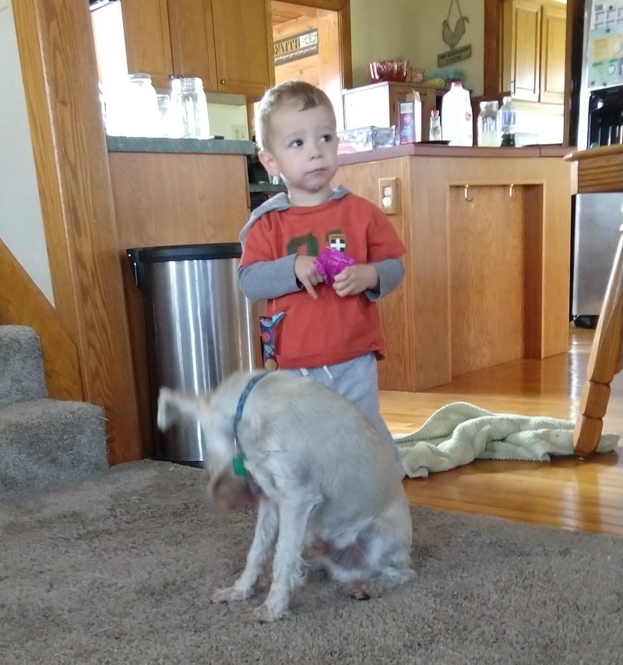

Likes
Pwning N00bs with my Wife Casey, spending time with my adorable and dauntless son Elijah, and Sleep.
Dislikes
Fixing poorly designed data models.

Slide 4
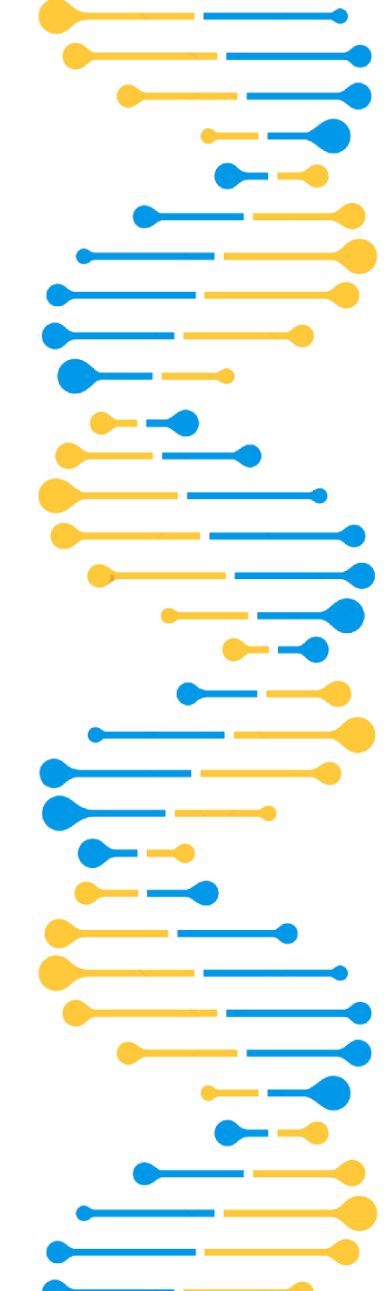

GROWING UP
(Maturing in your Data Model Structure)

Slide 5
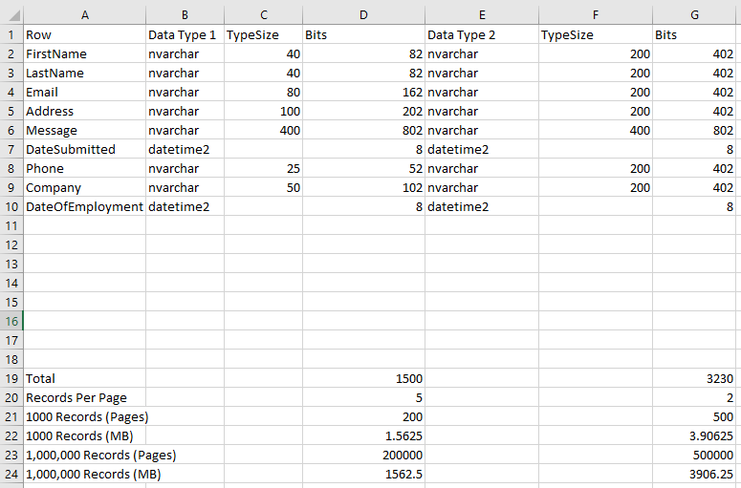
Growing Up – Maturing in your Data Model Structure
Look up Speeds
-Finding Records impacted both by number of records, size of records, and comparison logic of lookup.
-CPU to match or compare a number (123) drastically simpler than “Hello World”
-Sample 2.25 million row database of 4 ints, 3 bit ints, and 1 nvarchar(max) (no indexes), performing a 100 loop lookup
int: 18 seconds, bigint: 23 seconds, and nvarchar(max) took 1 minute 48 seconds
-Indexing can also be very important
Record Size
-Microsoft TSQL, Page = 8kb, each page has 96 byte header, so 8096 bytes remaining for records

Slide 6
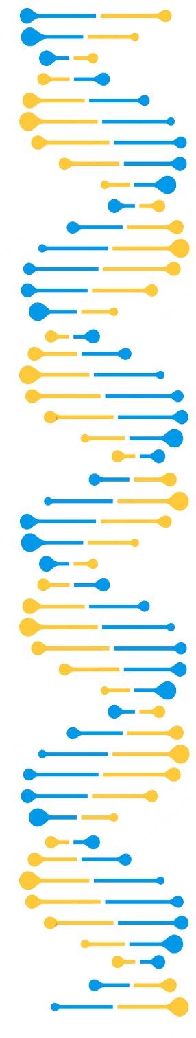
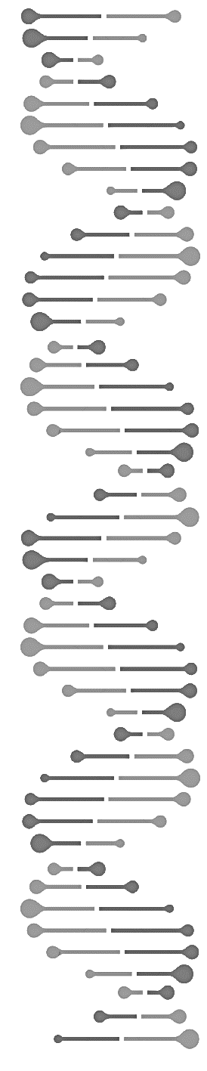

INBREEDING
(Additional Columns Based Relationships)

Slide 7



Inbreeding – Additional Column Based Relationships
Banner1, Banner2, Banner3….
This method is where you expand your data model to contain the related items data, adding more columns for each additional relationship you need to account for. Often the worst method to use.
Never have to do lookups for relationships!
Some job security
, maybe?
Data Model Size Bloat and Empty Spaces
Little to No Ordering Capability
Can we have another one?....
Display Markup Code Degradation
When to Use?
No other Option
Exact # of Relationships and can never change (ex Days in a Week)

Slide 8


KISSING COUSINS
(Serialized Objects in a Long Text Field)

Slide 9
Kissing Cousins – Serialized Objects in Long Text Field
JSON or XML Serialization
Store Serialized data (text representation of an object) in a column on your data model, to be retrieved and deserialized.
Can store almost any models, even arrays.
Serialized object can only be used by the main entity (no sharing)
Bloats size of data row due to serialized object (especially XML)
Must “Know” what object is being stored in that field, and how to handle it/deserialize.
Usually requires a Custom User Interface to update the model if customer facing.
When to Use?
Adding attribute type data, such as SEO meta data, Product customization. Flexibility in extending the model without the need of adding additional fields.

Slide 10
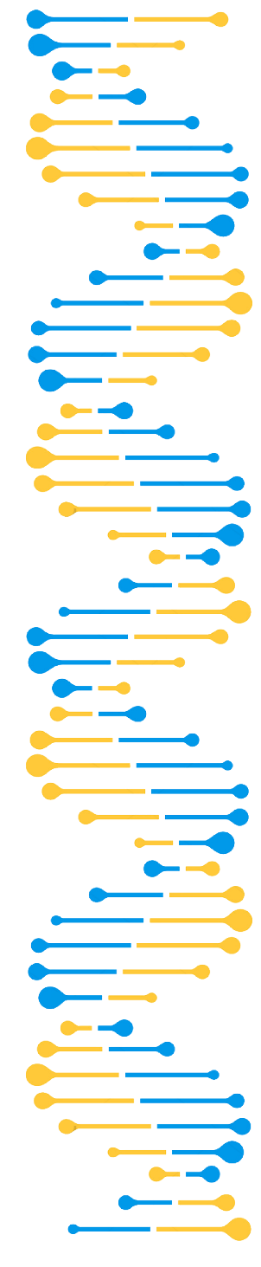

SHOTGUN
WEDDING
(Codename/Guid Referenced Column)

Slide 11
Shotgun Wedding – Codename/GUID Reference Columns
A quick and dirty way to Git’er done!
Storing relationships using a string (code name), GUID, possibly delimited for multiple entities. No Foreign Key Constraints.
Storing a CodeName (unique string) or GUID is a legitimate way to link two objects together
Performing Lookups can still be easy and fast (with indexes)
If operating in a Staging Environment, no need to translate between environments
Still not the best for Lookups if no index
No Foreign Key Constraint = Orphan References if the other item is deleted.
When to Use?
Budget, time, or platform capabilities are limited and prevent more proper ID references and binding tables.

Slide 12




ARRANGED MARRIAGES
(Convention/Contract Based Relationship)

Slide 13
Arranged Marriages – Convention/Contract Based Relationship
It can work if you follow along
Relationships that are based on some convention, such as a Naming Convention (Starts with…) or Paths (Tree Structure)
Can be very easy to code and set up
Usually impervious to environment changes / deletions
Ordering can also be easy if in a Tree Structure
Editors or Data Modifiers must be careful to follow the conventions set down by the designer
In some cases, can be hard to “share” items between two relationships.
When to Use?
You have confidence in your Editors/Data Modifiers and the pros outweigh the cons, and the conventions make logical sense.

Slide 14
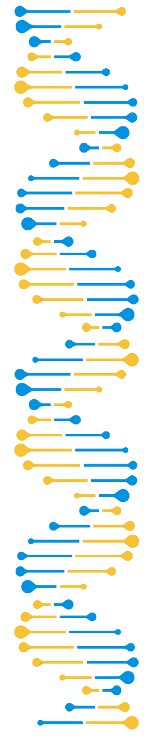
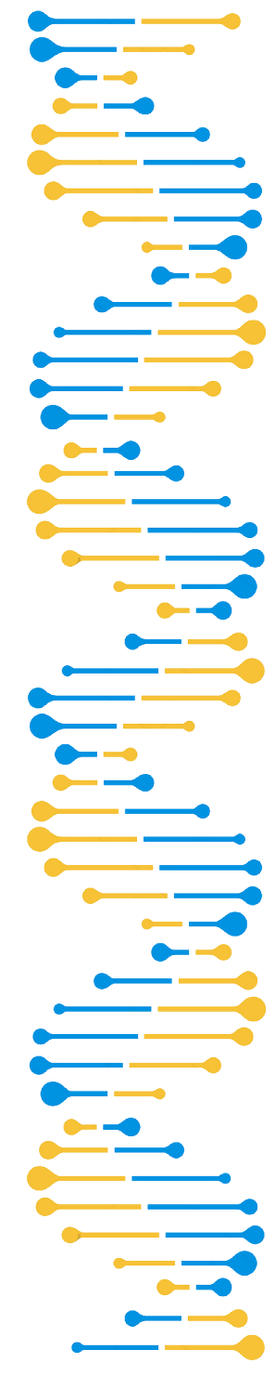





POLYGAMY
(Relationships Based on a Shared Relationship)
+

Slide 15
Polygamy – Relationships Based on a Shared Relationship
A Shared Relationship that Binds
Relationships that are based upon some other shared Relationship, often seen in Taxonomy (categorization), or relationships by reference (ex Car – Wheel – Company link)
Very flexible relationship model.
Usually very easy to add new Taxonomy/Categories and assign.
Little to no control over what is also related to your item, anything could be added.
When to Use?
Whenever the relationship makes sense to use, and you can limit what content is returned that is applicable.

Slide 16


HOLY MATRIMONY
(Int ID Binding with Proper Constraints)

Slide 17

Holy Matrimony – int ID Binding with Proper Constraints
The best of all worlds
Items that are linked through an int ID field or ID to ID binding table, with Foreign Key Constraints to handle deletions. Should use whenever possible as it’s the optimal type of relationship lookup.
Very Fast lookups and Joins, automatically indexed for full data
Setting up Foreign Key Constraints can properly cascade deletion of parents on children, or removal of binding table entry
Requires more effort to set up Foreign Key Constraints
Sometimes requires ID translation when moving between environments

Slide 18


